Slide 1
Flynn’s Taxonomy
Spectrum of Computing Paradigms

Slide 2
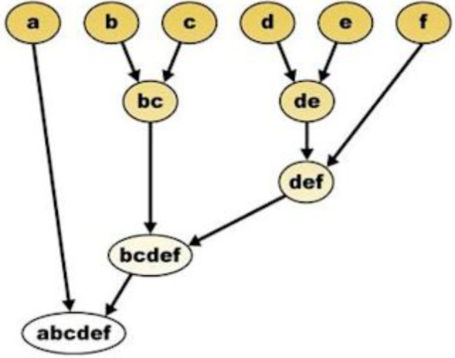
What is a Taxonomy?
The practice and science of categorization and classification!
Essentially follows a hierarchy, a bunch of entities are organized and classified into groups or types.

Slide 3

Flynn who?
No, not him!

Slide 4

Michael J. Flynn
Professor emeritus, Stanford University
Dissected the computing paradigm, brought together a relation between key aspects to correlate between architectures
So, what is Flynn’s Taxonomy?

Slide 5
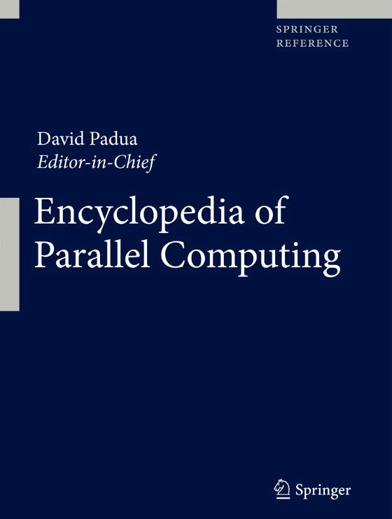
An article for the ages!
Flynn, M. (2011). Flynn’s Taxonomy. In: Padua, D. (eds) Encyclopedia of Parallel Computing. Springer, Boston, MA. https://doi.org/10.1007/978-0-387-09766-4_2

Slide 6
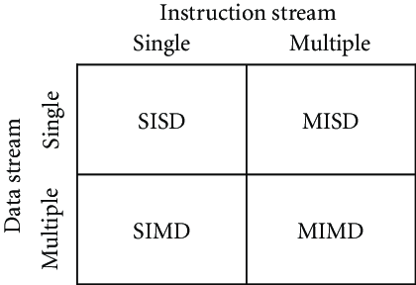
Flynn’s Taxonomy
Categorizes existing architectures into four segments primarily with the help of two key aspects - Instruction density and Data density

Slide 7
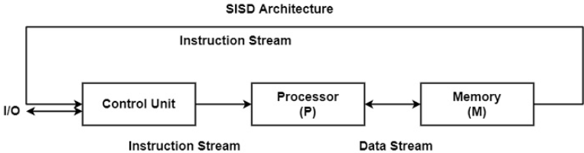
SISD (Single Instruction, Single Data)
The trivial serial computer in use!
SISD defines a computer organization with a control unit, a processing unit, and a memory unit.
Executes instructions sequentially and they can/cannot have parallel processing efficiency.
How can we parallelise further?

Slide 8
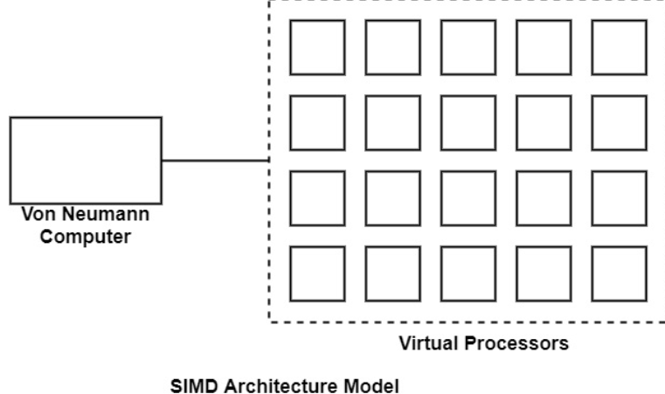
SIMD (Single Instruction, Multiple Data)
A form of data level parallelism! This is exactly what we achieve with CUDA!
The SIMD model of parallel computing includes two parts such as a front-end computer of the usual von Neumann style, and a processor array as displayed in the figure.

Slide 9
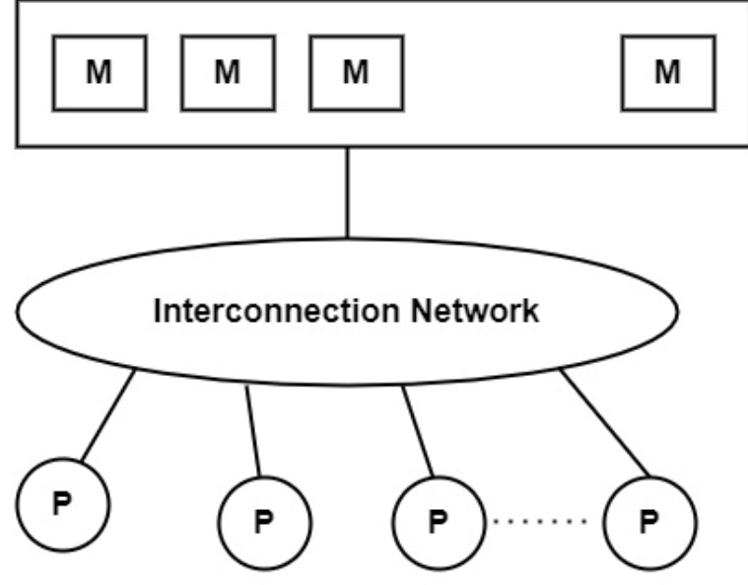
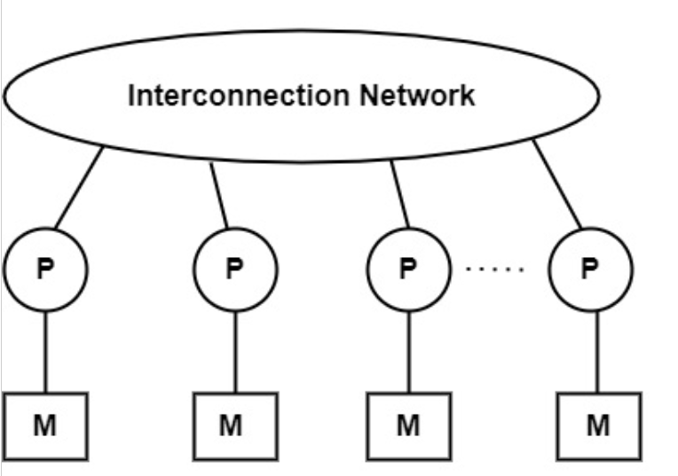
MIMD (Multiple Instruction, Multiple Data)
Introducing multiple nodes to handle different sets of data.
Think of multiple processors having their own chunk of memory! Each processing element gets its own share of the cake!
Multi-tenancy execution is favorable.

Slide 10
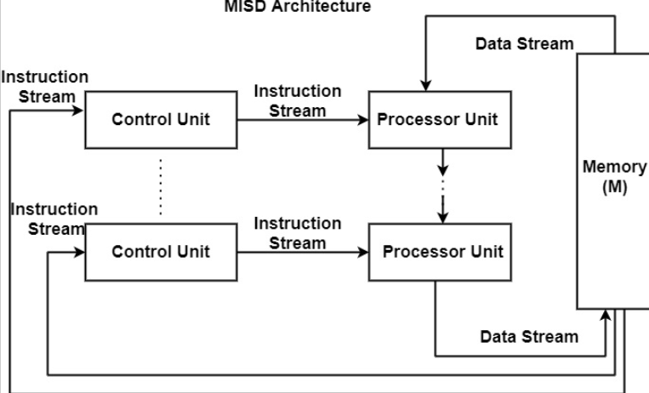
MISD (Multiple Instruction, Single Data)
The most debated classification segment.
One might argue that pipelining doesn’t necessarily portray the flow of one piece of data, considering how it evolves with each stage!
Structure looks too impractical to be included in real world high performance systems.

